Slide 1
Marketing Campaign Management

Slide 2

Project
Group Number -- 16
P.Sai vinay 172309
Mentors: Manish Rajahans
Notes:
Add instructor notes here.

Slide 3
Objectives
Project Understanding
Approach used
Project Execution
Modules
Learning
Best Practices
Opportunity for improvement
Demo and Code Walkthrough
Q&A
Notes:
Add instructor notes here.

Slide 4
Abstract
This project is aimed at developing a Marketing Campaign Management (MCM) for marketing and sales team. This is a web based application that can be accessed via internet. MCM is an enterprise solution for managing different marketing campaigns for the organization. The primary goal of the application is to create and start marketing campaign and keep track of prospect lead gathered by marketing team.
Notes:
Add instructor notes here.

Slide 5
Project Understanding
XYZ Services Ltd launched in 2016, is an India – based laptop manufacturer that has rapidly grown in past 1 year. This has been possible because of high performance and low cost indigenous devices that fulfill the needs of Indian consumers.
Observing the positive approach of consumers toward their product, company has decided to launch marketing campaign across the corporate office of various MNC’s to further increase its sales.
Administrator will play the vital role of generating new campaigns and marketing executives will be responsible for recording lead data related to campaign assign to them.
Notes:
Add instructor notes here.

Slide 6
Approach used :
SQL Server 2012: Database Layer.
NET Framework 4.5 + C# 5.0 :Developing Business components (C# classes).
WPF 4.5: Presentation Layer.
Notes:
Add instructor notes here.

Slide 7
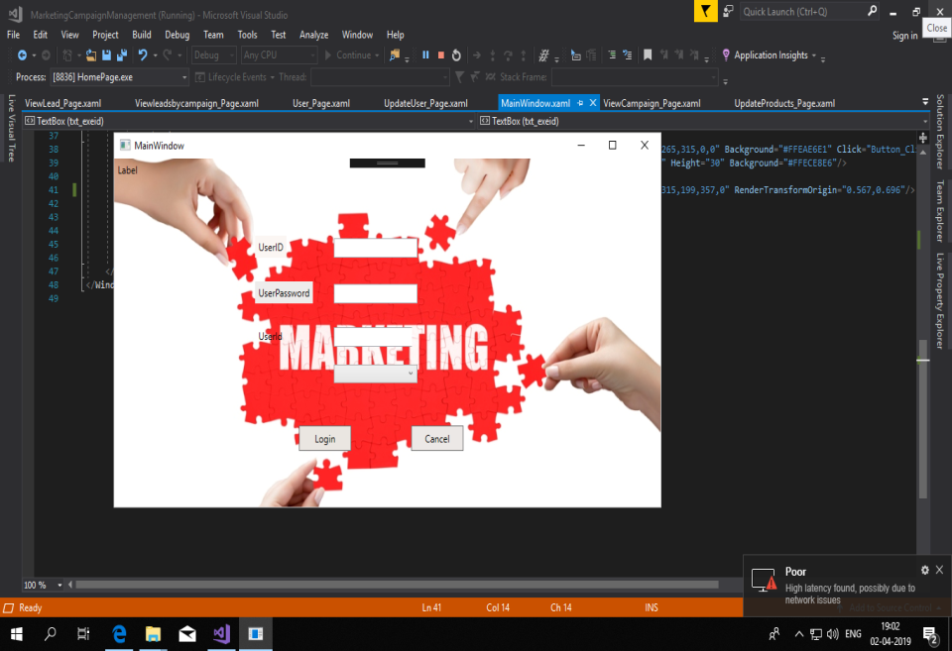
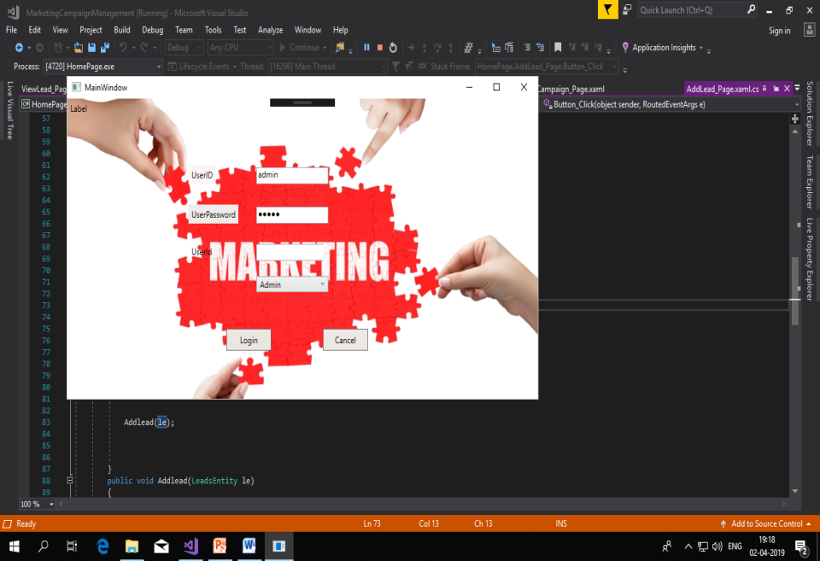
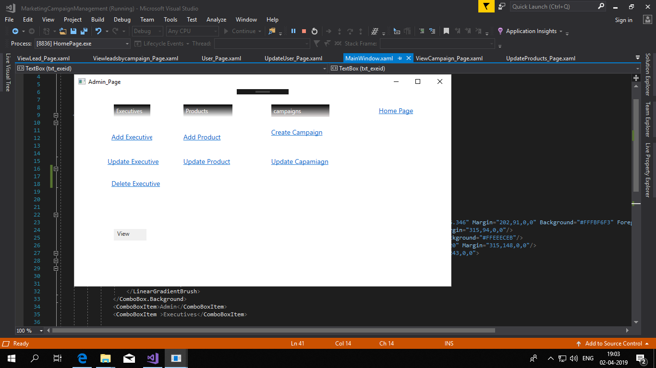
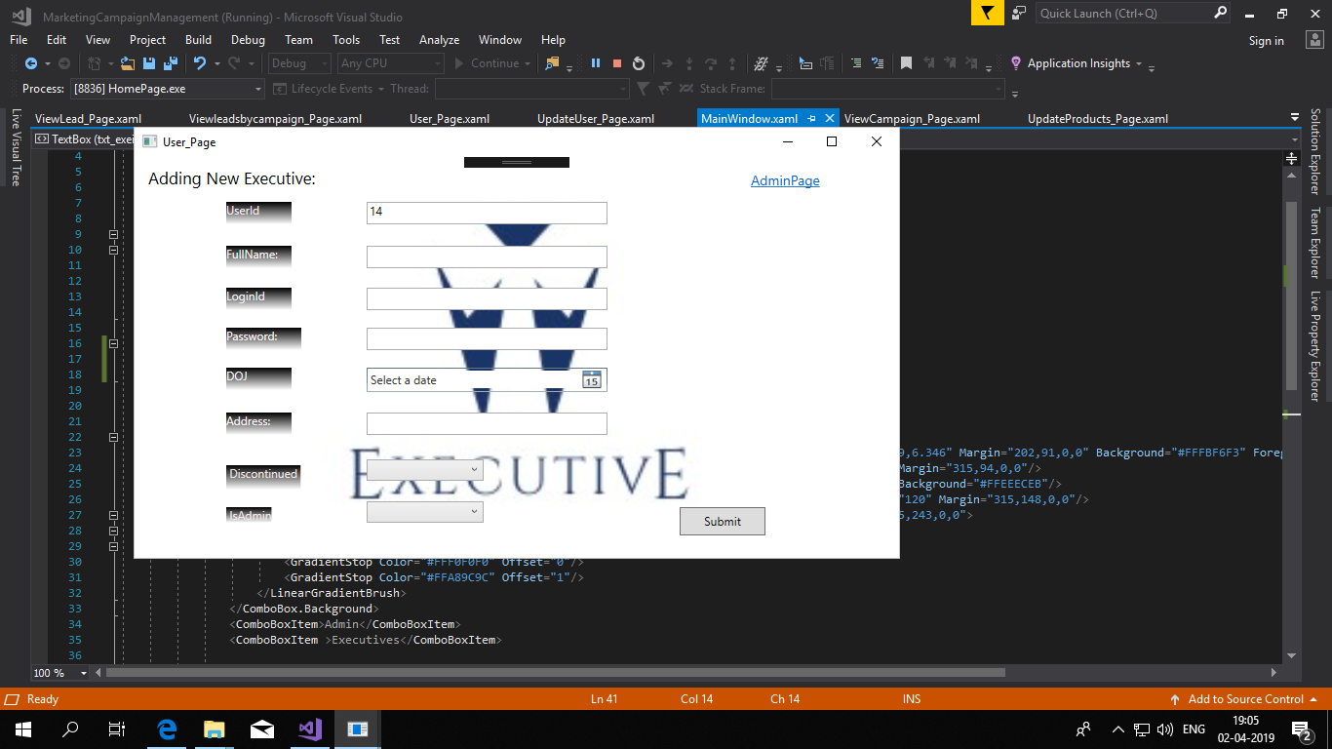
Project Execution
Notes:
Add the notes here.
Add instructor notes here.

Slide 8
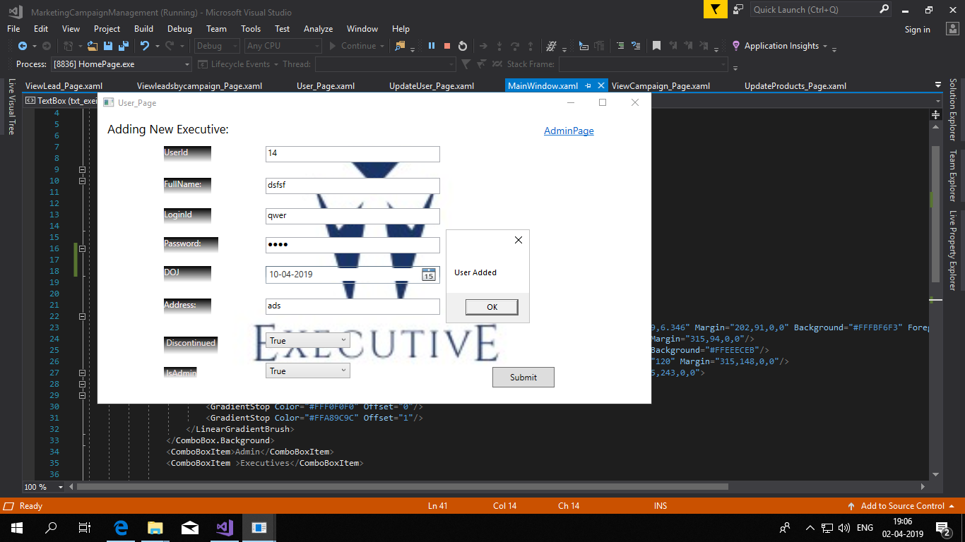
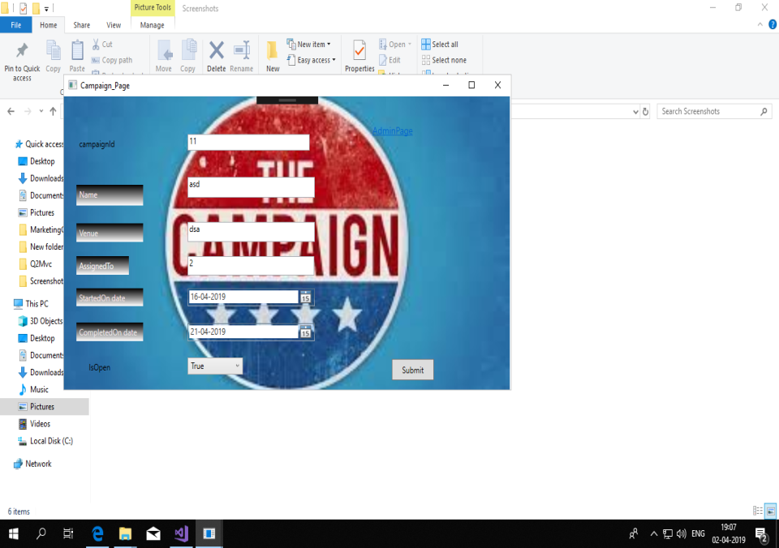
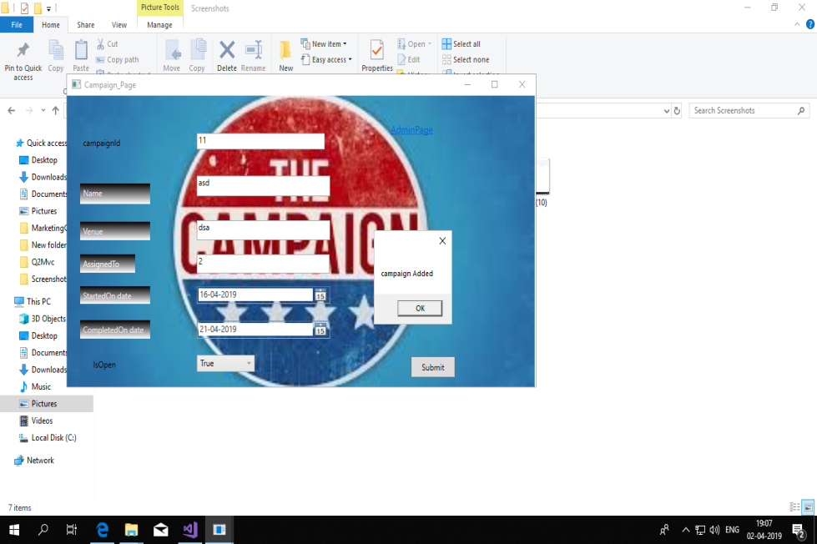
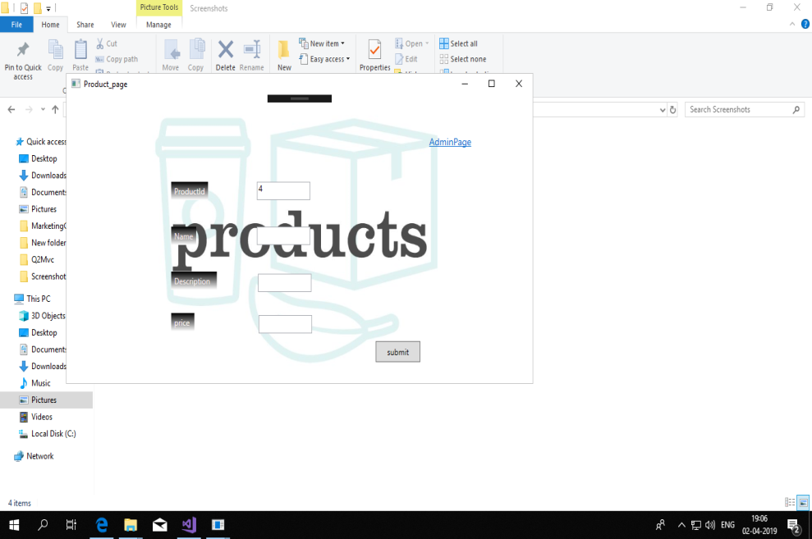

Slide 9
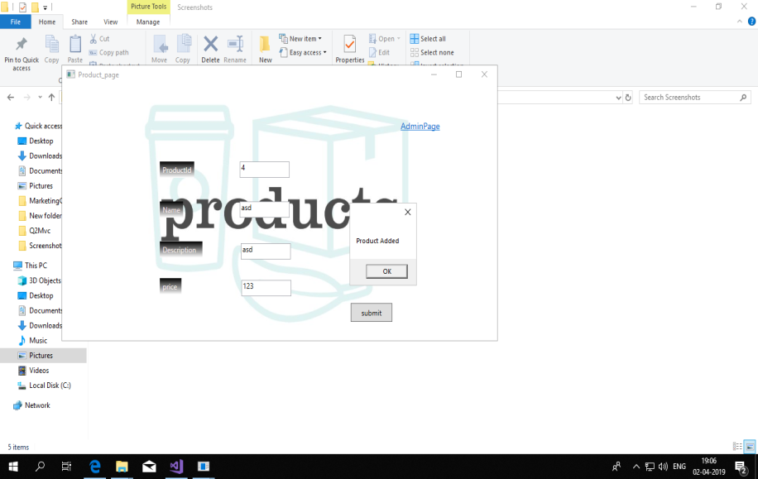
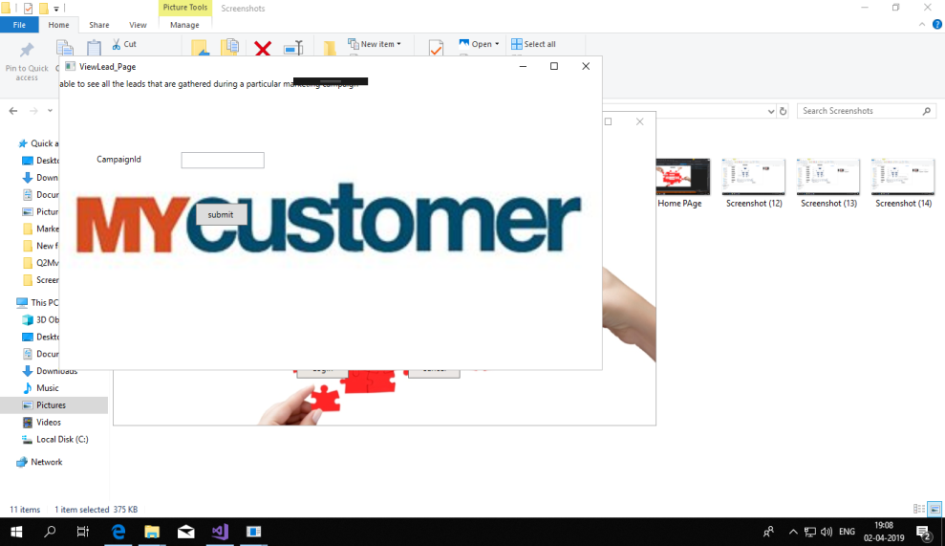
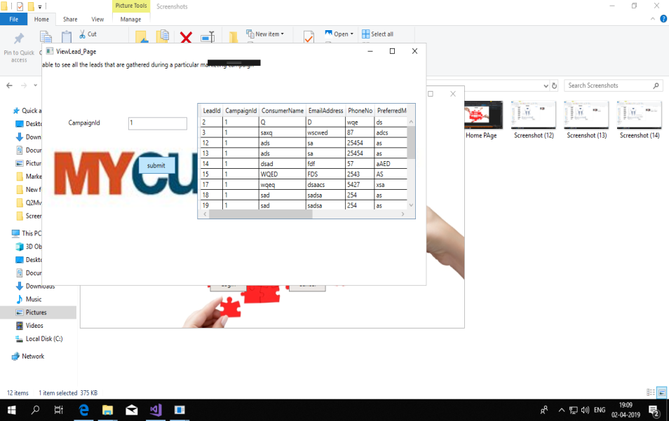
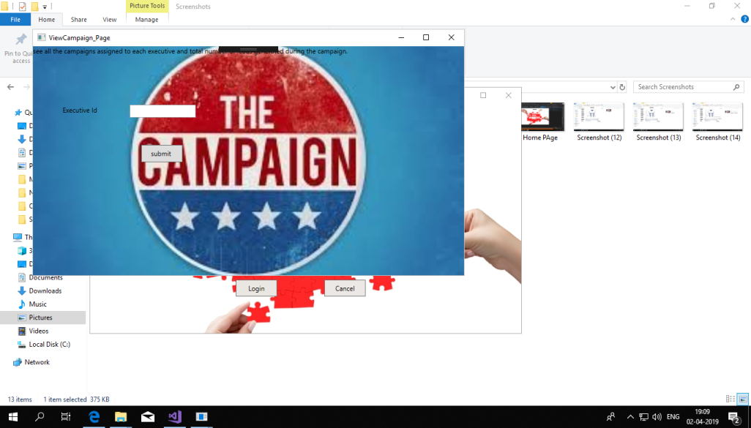

Slide 10
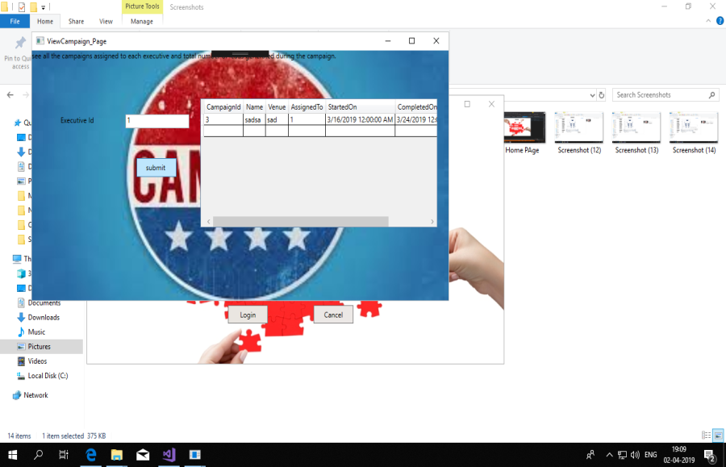
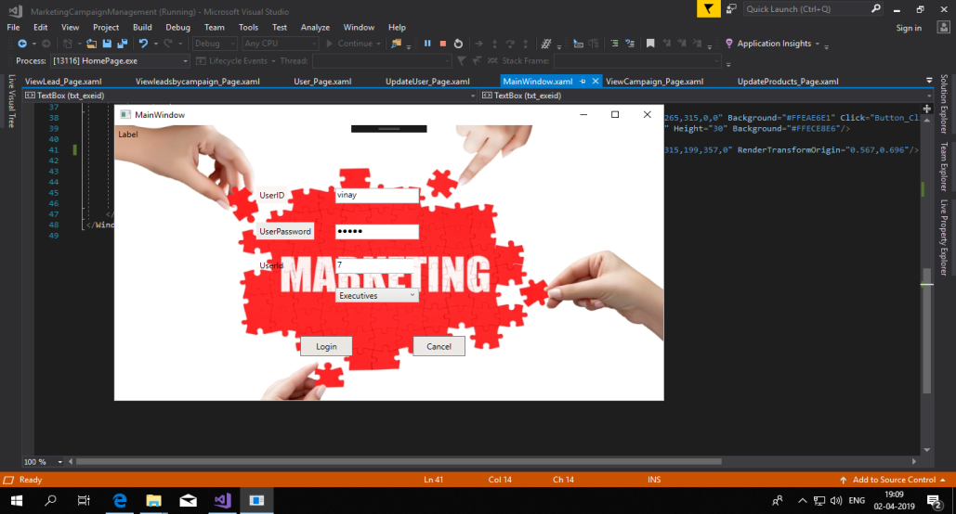
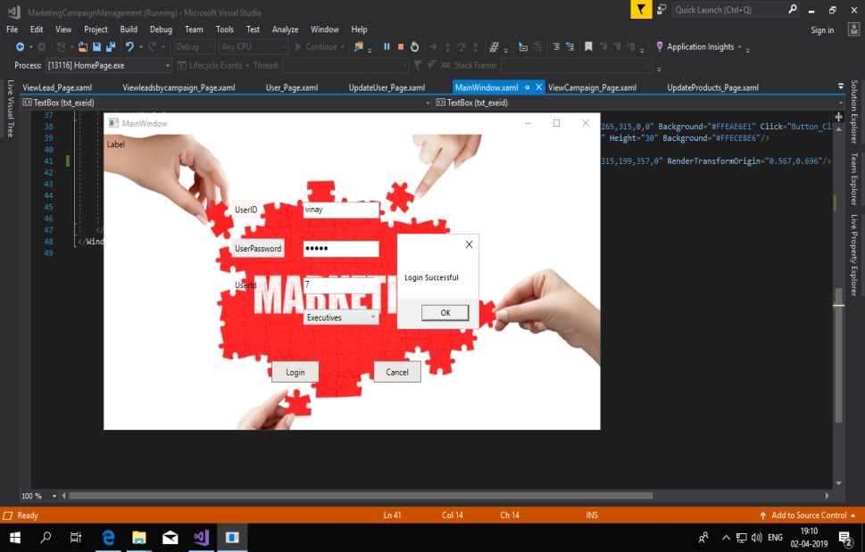
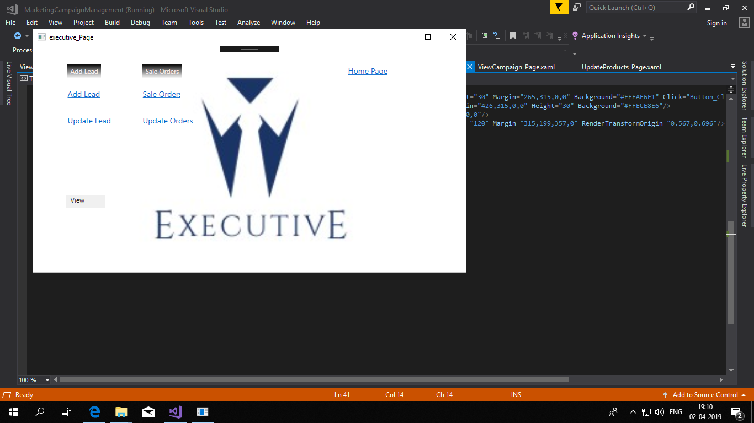

Slide 11
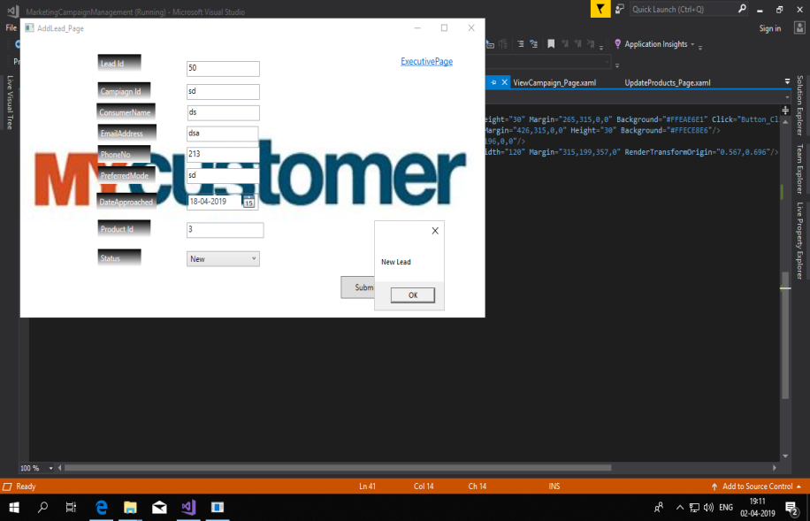
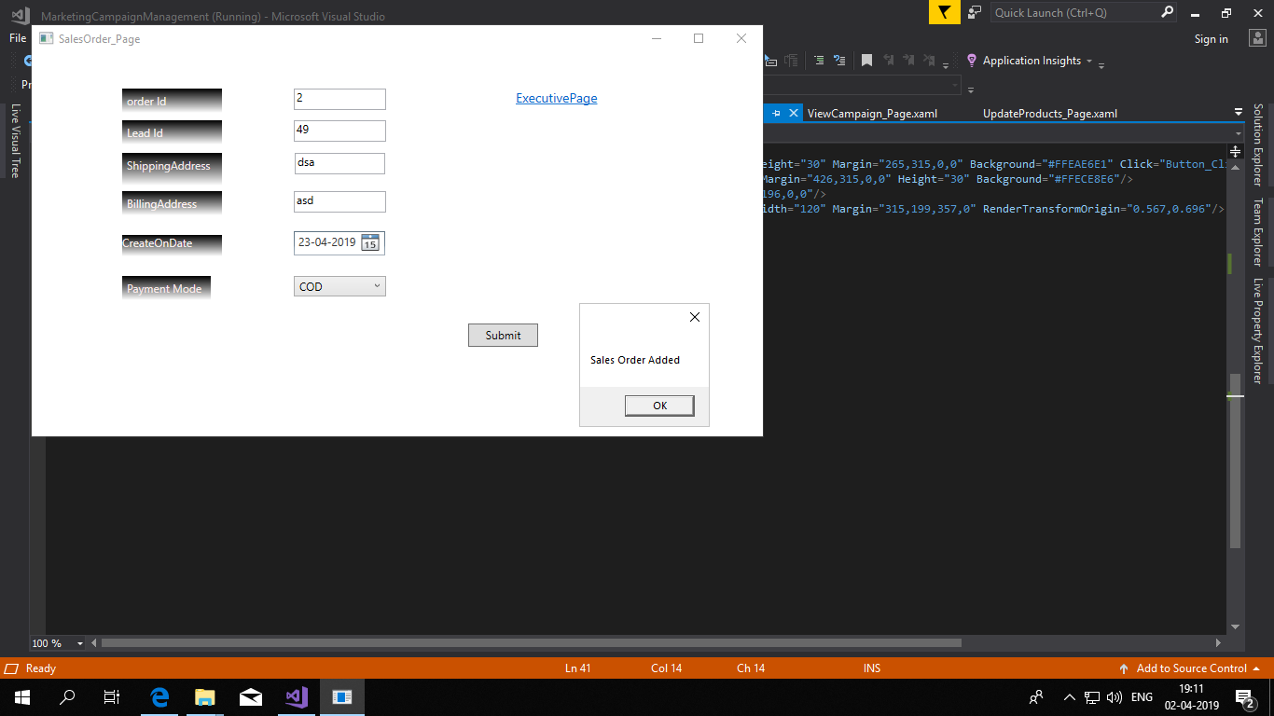
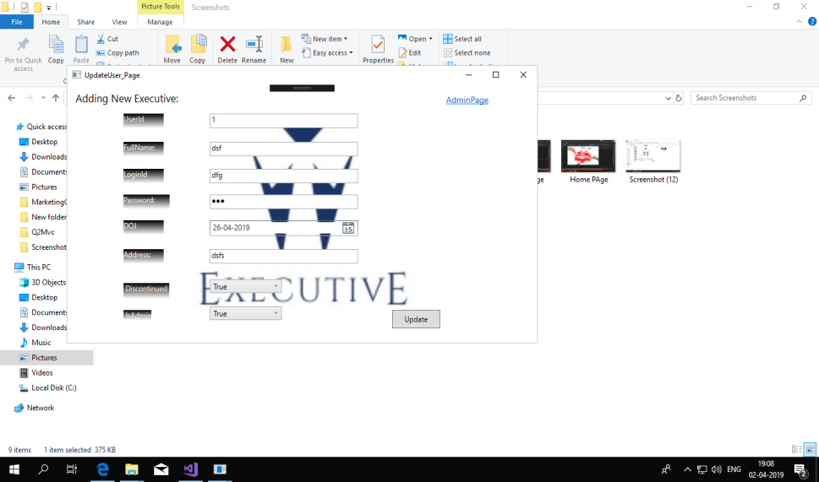


Slide 12
Modules Role of Administrator
Administrator is the primary user of the application and will have the complete control over the marketing campaigns.
Add Product
Add users
Create Campaign
View Lead by campaign
View Campaign by executive

Slide 13
Modules Role of a Marketing executives
Marketing executive which are added by administrator will login to the system and performs the following operations.
Add Lead
View leads by campaign
Lead follow up
Create Sales Order

Slide 14
LEARNING
Here in this project we have used ADO.Net and WPF to build the solution.
In this we project we learnt about the role of admin and user.
To add styles and background images to the project WPF is used.
Learnt to connect database to the visual studio.
By using ADO.Net connected architecture we performed CRUD operations in data access layer.
Validation are given in business logic layer to validate the required fields.

Slide 15
OPPORTUNITY FOR IMPROVEMENT
Improving the interaction between admin and executive.
Making the views of my project more simple and transparent

Slide 16
BEST PRACTICES
In this project I have used Layered architecture to build the solution.
In entity layer we need to give the variables.
In exception exception layer handles the exceptions occurred in the application.
In Data access layer all the CRUD operations are done.
In Business access layer all the validations were performed.
Naming conventions were given right and are understandable so there are no mistakes in the naming.

Slide 17
Thank You

